Slide 1


Slide 2


Presentation On Letters And Their Types
Communications Skills
Letter and Memo Writing

Slide 3
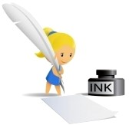
Contents:
Topics Page#
Letter 04
Types of letters 06
Types of formal and informal letter 08
Styles of letter writing 09
Parts of letters 12
Examples and samples of letters 15
Difference between Hard & Soft letter writing 19
Difference between letter and application 20

Slide 4
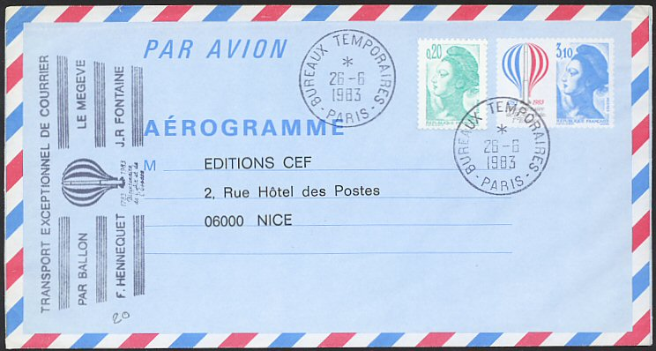
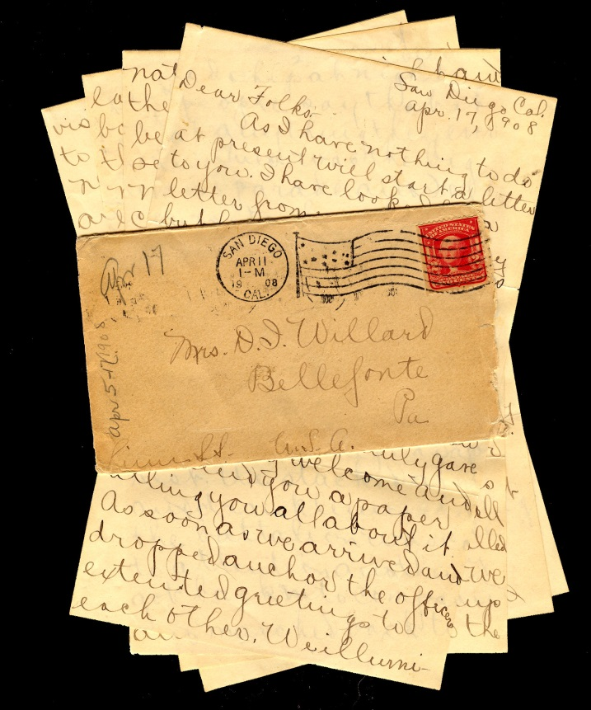
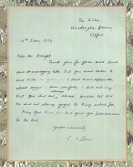
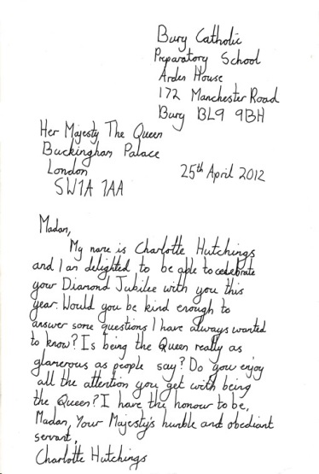
LETTERS

Slide 5

Letter:
A letter is a written or typed message from one person to another.
Historically, letters were the only reliable means of communications between two persons at different locations.
The role of letters in communication has changed significantly since the 19th century.

Slide 6
Types Of Letters
There are two basic types of letters.
Formal Letters
Informal Letters.
Formal Letters:
A formal letter is a letter written to a business, a college, or any professional that are not considered friends or family. These are also called official letters.
Informal Letters:
An informal letter is a letter written to a friend or family. These are also known as personal letters.
Electronic Mail (email):
Messages distributed by electronic means from one computer user to one or more recipients via a network.

Slide 7
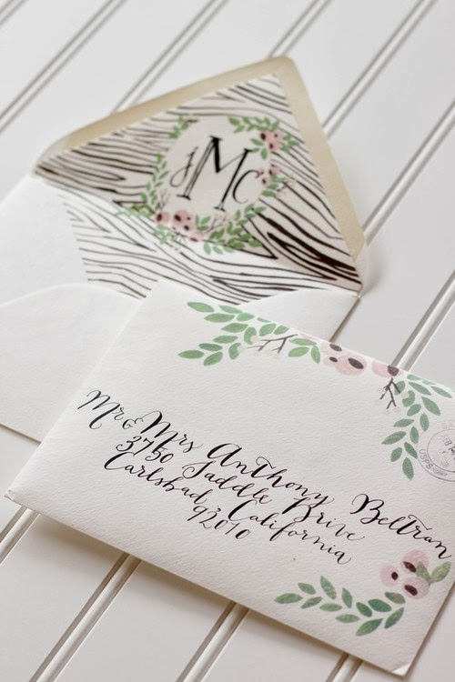
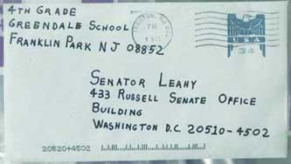

Informal Letters
Formal Letters
Electronic Mail

Slide 8
Types of formal and informal letters
Formal Letters
Informal Letters
Cover Letters
Résumé
Follow-up-Letters
Accepting Job Offers
References
Apologies
Complaints
Invitations
Offering Condolences
Appreciation and Thank you

Slide 9
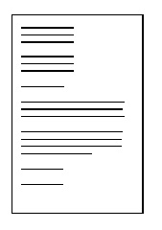
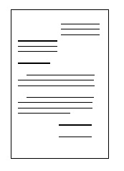
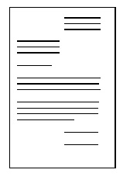
Styles of letter writing
Block Style
Semi Block Style
Modified Block Style

Slide 10
Block Style:
A full block style business letter is when all the components of the letter are aligned at the left margin. Side, top and bottom margins should be 1 to 1 1/4 inches. Font size should be 12 in times new roman.
Semi Block Style:
All text is aligned to the left margin, except the date, attention line, and complimentary close. Paragraphs are separated by double or triple spacing.
Modified Block style:
In this style we usually put all text aligned to the left margin, except for the author's address, date, and complimentary closing. All paragraphs we write in a modified block style are not indented. The author's address, date, and closing begin at the right. See the following modified block style sample.

Slide 11
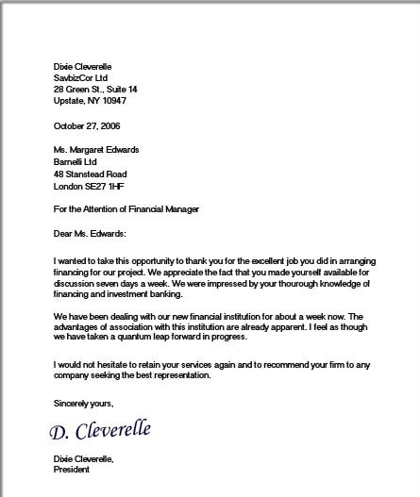
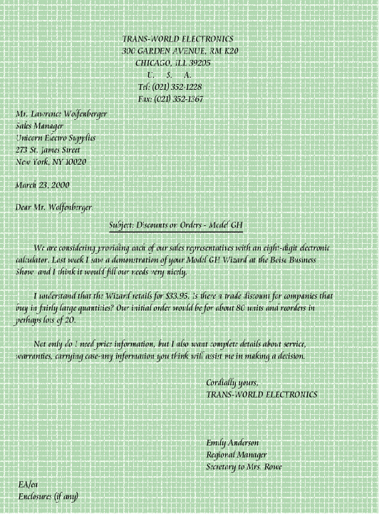
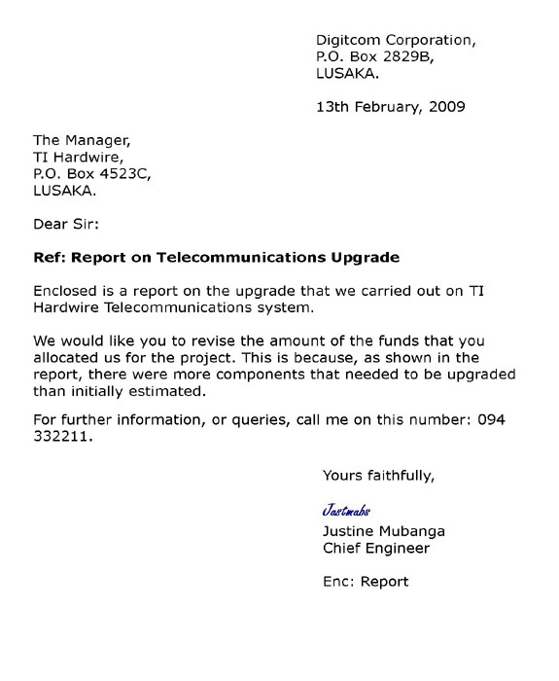
Block Style
Semi Block Style
Modified Block Style

Slide 12
Parts of a letter:
Letterhead
The date of the letter
The Inside Address
The Greeting / Salutation
Title
Introduction
The Body Paragraphs
The Complimentary Close
Signature and Writer’s identification

Slide 13
Compulsory and optional parts
1. Heading (or) Letterhead
2. Reference (or) File Number (optional)
3. Date of The Letter
4. Private and Confidential (optional)
5. Recipient’s Address (Style of Address)
6. Attention Line (optional)
7. Salutation
8. Subject of The Letter (optional
9. Body of The Letter
10. Complimentary Closing (optional)
11. Signature
12. Name and Designation
13. Postscript (optional)
14. Enclosures (optional)
15. Typist’s Name and Initials (optional)
`

Slide 14
Things to keep in mind while writing letters:
Dear Sir or Madam,
If you do not know the name of the person you are writing to, use this. It is always advisable to try to find out the name.
Dear Mr. Asfand,
If you the name, use the title (Mr, Mrs, Miss or Ms, Dr, etc.) and the surname only. If you are writing to a woman and do not know if she uses Mrs or Miss, you can use Ms, which is for married and single women.
Be clear , brief and businesslike.
Be polite and friendly.
Write concise and purposeful letter.
Do not try to impress with you writing.

Slide 15
Ending a letter:
Yours Faithfully
If you do not know the name of the person, end the letter this way.
Yours Sincerely
If you know the name of the person, end the letter this way.
Your Signature
Sign your name, then print it underneath the signature. If you think the person you are writing to might not know whether you are male or female, put your title in brackets after your name.

Slide 16
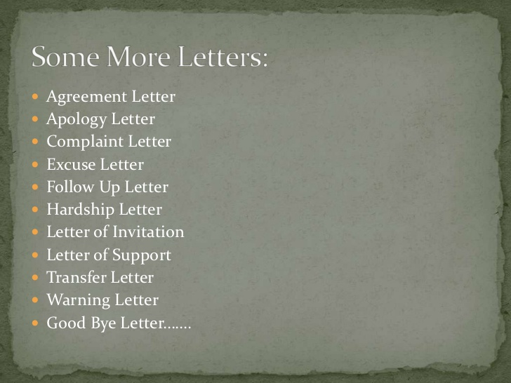

Slide 17
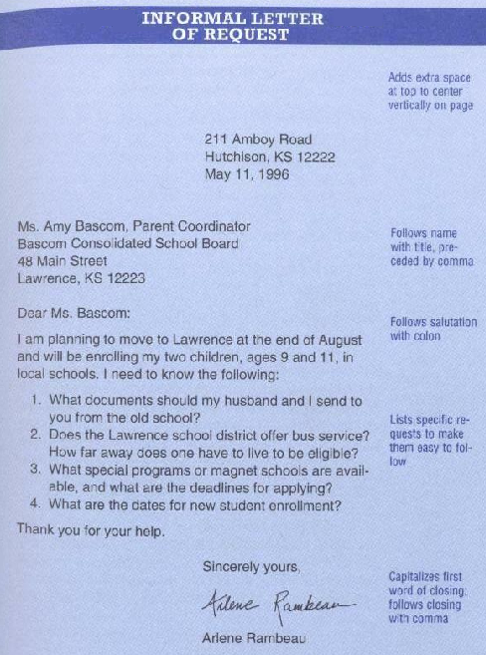
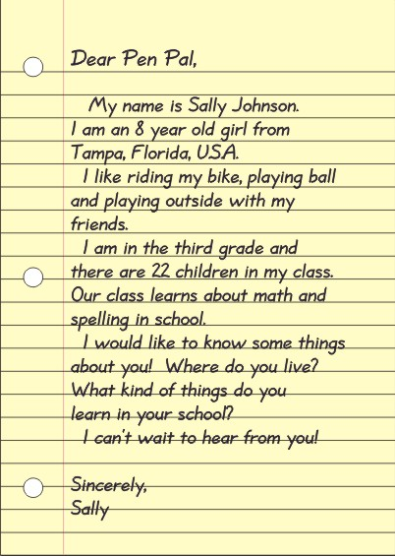
Samples Of Letters:

Slide 18
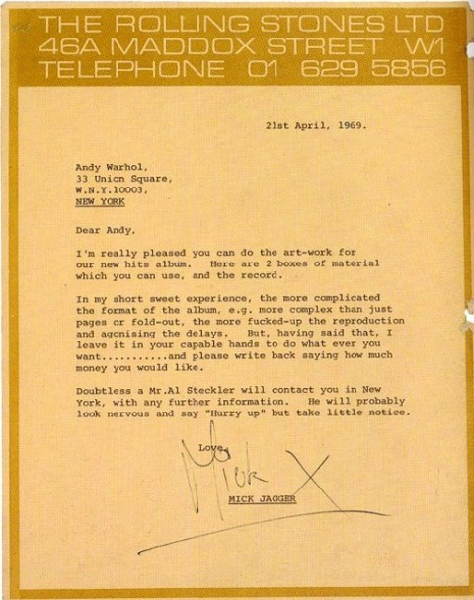
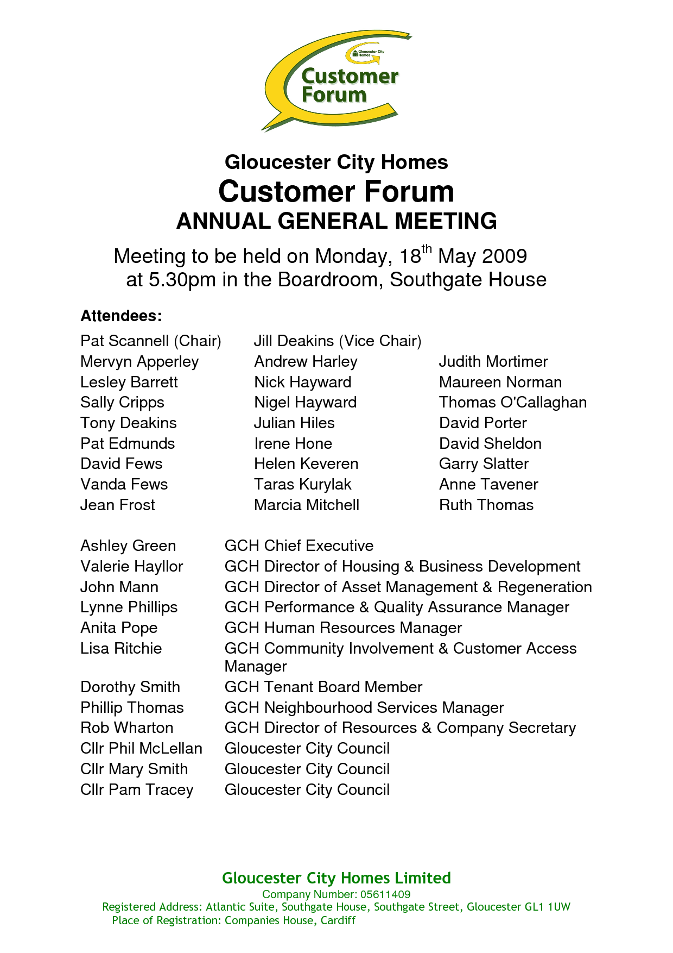

Slide 19
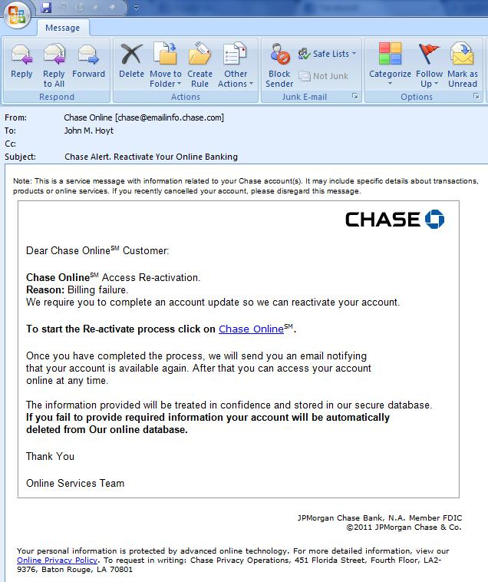
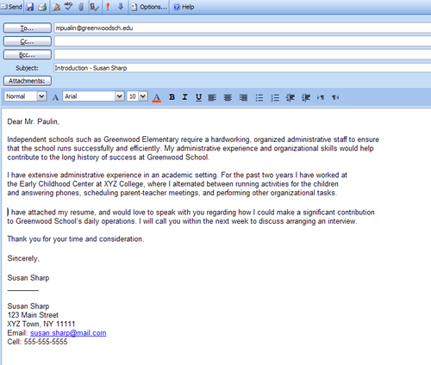
Samples Of Electronic Mail (email)

Slide 20
Difference between Hard letter and Soft letter writing
Hard Letter Writing
Soft Letter Writing
Hard letters are in the form of printed or written on pages.
Hard letters do not need any electronic mean to read them.
Soft letters are in the form of soft copies.
These can either be saved in cd’s, hard disks or flash drives.
These can also be electronic letters.
Soft copy letters need electronic means to read them.

Slide 21
Difference Between Letter And Application:
Letter
Application
A letter you write because you are replying to someone or letting someone know what is happening.
In formal letter you have to mention the subject
Writing a letter you can explain your purpose in more than one or two paragraphs.
An application is written to apply for something.
Application is not having a subject.
While writing an application you summarize your purpose.

Slide 22
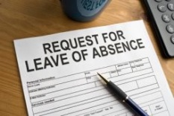
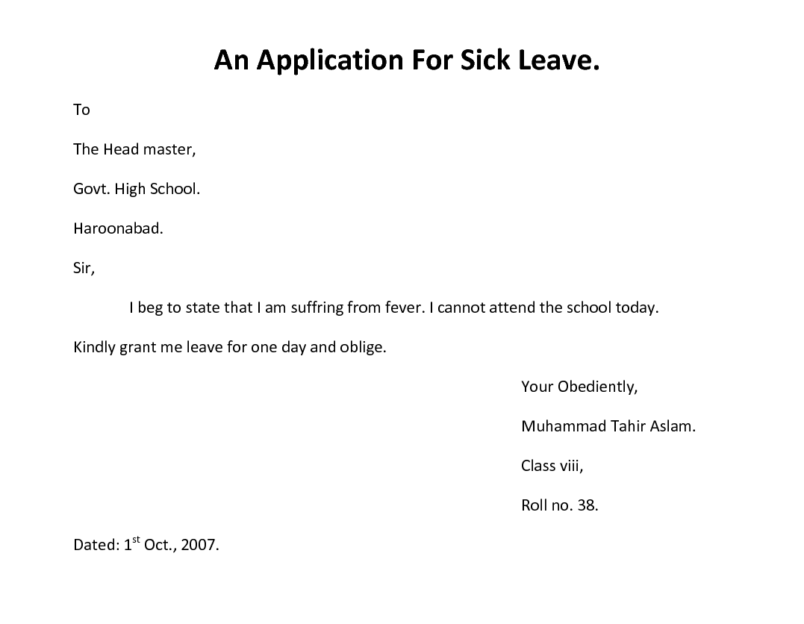
Application

Slide 23




